Slide 1
Submission and Review of Quality Improvement Projects
Wolff Center at UPMC

Slide 2
Goals
Streamline QI project submission and review process to increase efficiency.
Provide resources to project sponsors for development and implementation of projects.
Develop database for shared system learning.

Slide 3

New Policy and Process (6/1/15)
Electronic submission and review
Use of QI or research checklist
Two-tiered review:
  First level by core QI review committee
  Second level for complex projects by expanded committee (OSPARS, SCM, IRB, System P & T, Registry Team, Corporate Compliance, New Technology Device Request Group)
Infonet site for all aspects of the work

Slide 4
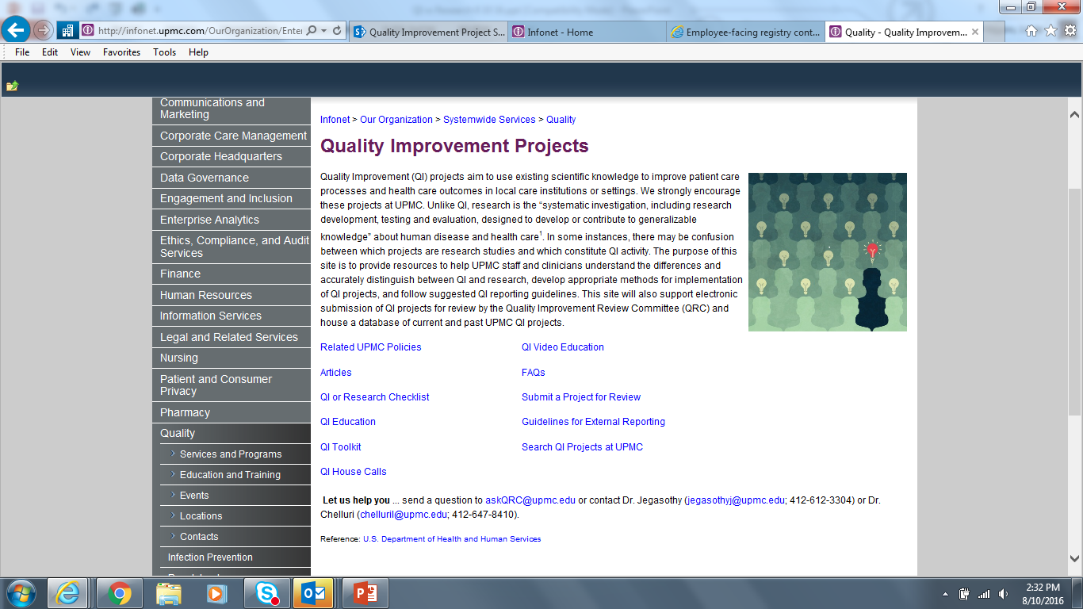
INFONET (Quick Links A-Z List, Select Q)

Slide 5
INFONET/Quality Improvement Projects

Slide 6
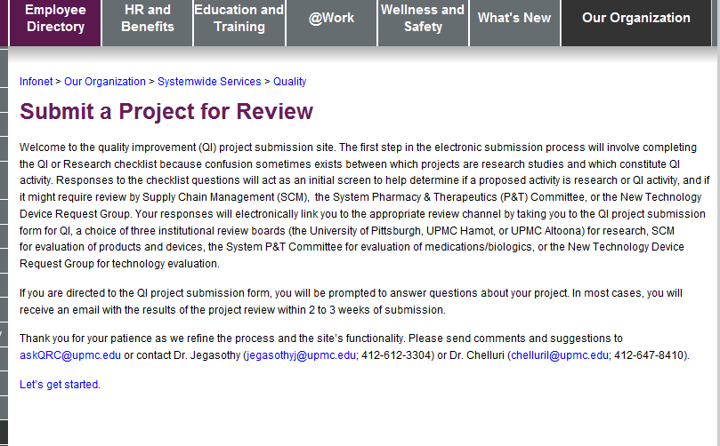


INFONET/Quality Improvement Projects

Slide 7
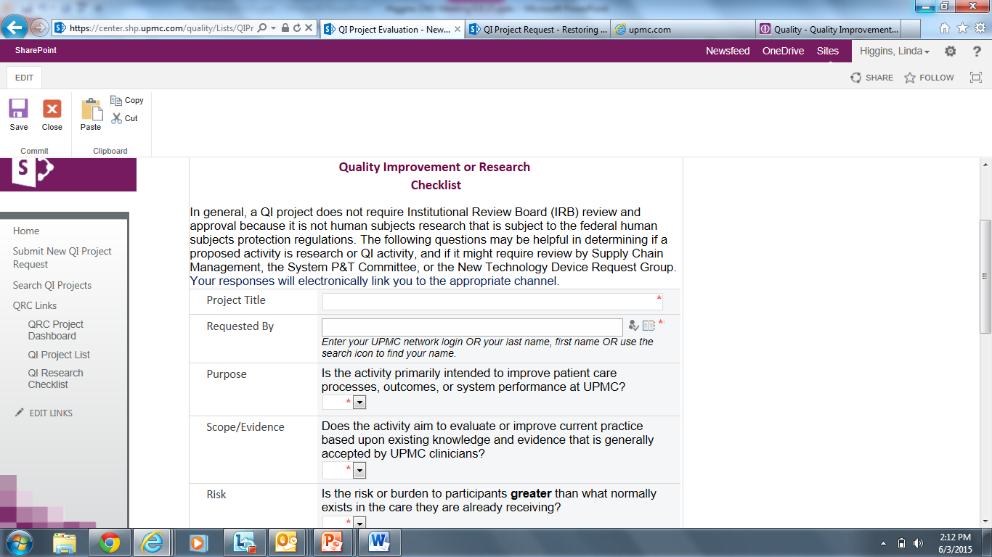
Submit a Project for Review

Slide 8
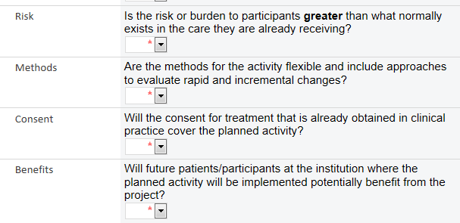
QI or Research Checklist

Slide 9
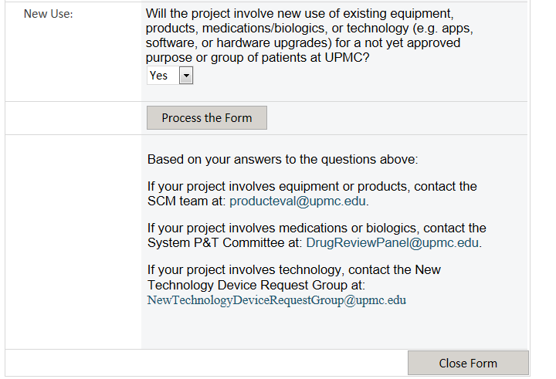
QI or Research Checklist

Slide 10
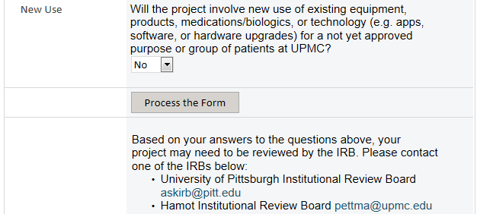
QI or Research Checklist

Slide 11
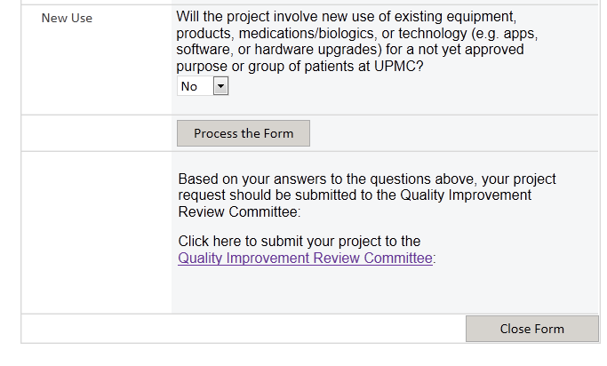
QI or Research Checklist

Slide 12
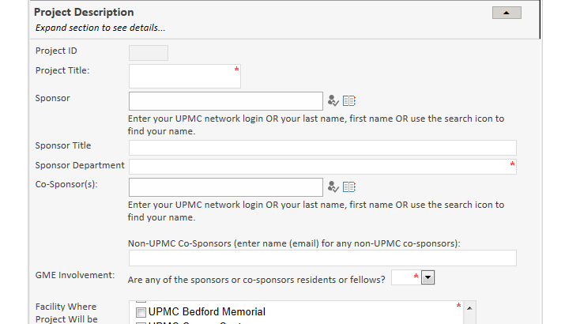
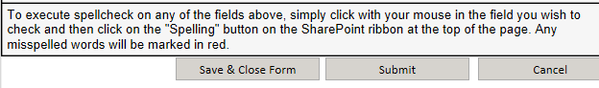
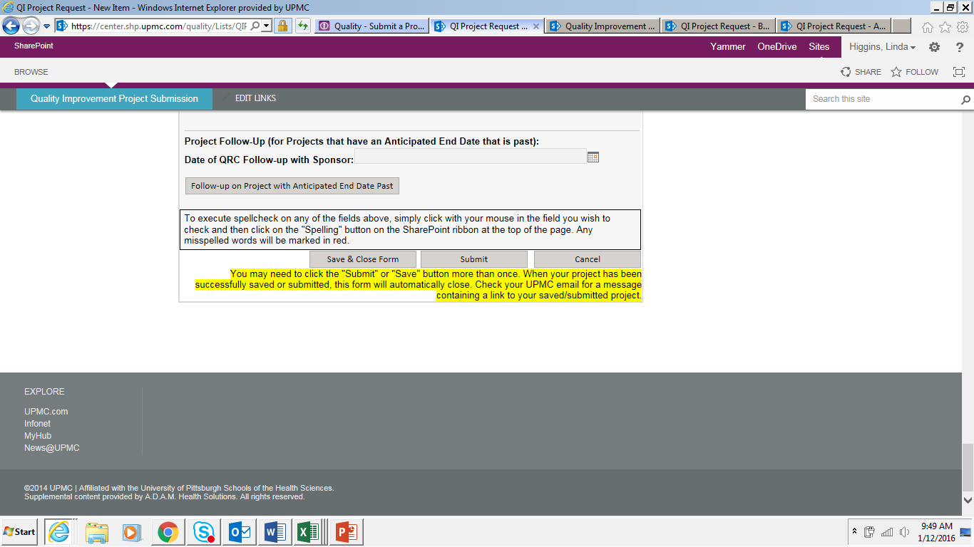
QI Project Submission

Slide 13
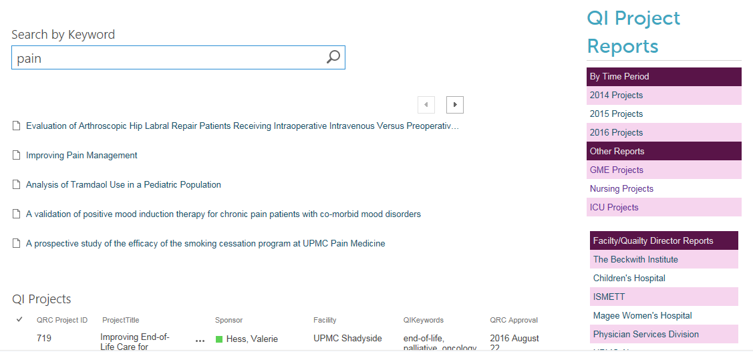
Search QI Projects at UPMC

Slide 14
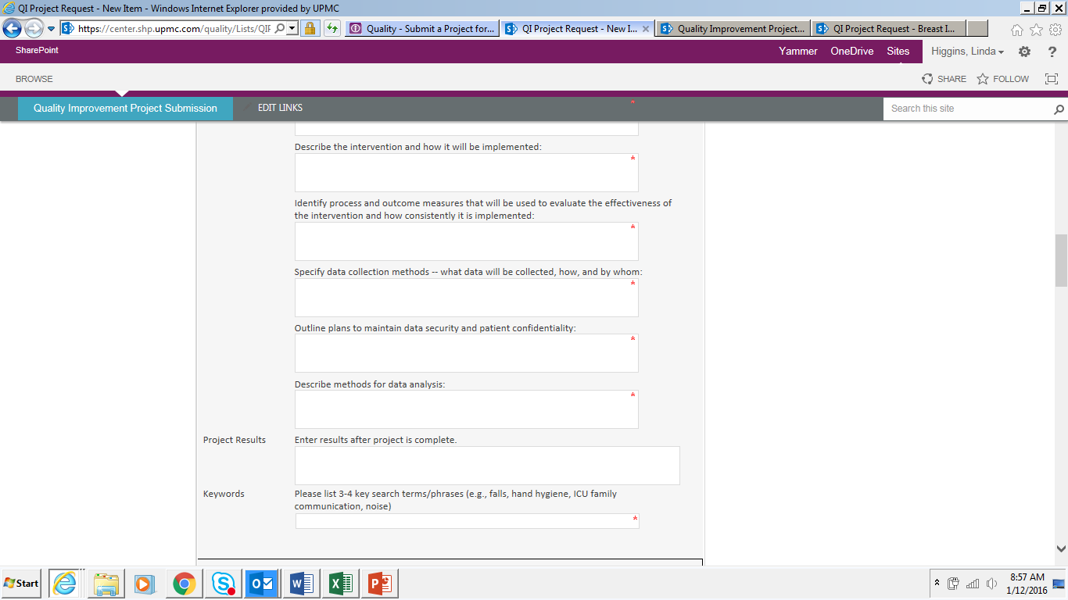
Add Results upon Completion

Slide 15
17 Month Summary
(June 1, 2015-November 9,2016)
Total projects approved 536
GME projects 159
Pharmacy resident projects 19
Completed projects 90

Slide 16
Projects by Facility
Facility |  | Count
UPMC Presbyterian |  | 105
Children's Hospital of Pittsburgh of UPMC |  | 65
UPMC Mercy |  | 54
UPMC Shadyside |  | 38
UPMC St. Margaret |  | 30
Magee-Womens Hospital of UPMC |  | 29
Western Psychiatric Institute and Clinic |  | 20
UPMC Passavant |  | 19
UPMC Hamot |  | 10
UPMC McKeesport |  | 10
Physician Services Division |  | 8
UPMC Senior Communities |  | 8
UPMC Cancer Centers |  | 8
UPMC Health Plan |  | 7
UPMC East |  | 5
UPMC Horizon |  | 2
UPMC Altoona |  | 1
UPMC Bedford Memorial |  | 1
UPMC CRS |  | 1
UPMC Northwest |  | 1
Total at Single Sites |  | 422
*114 projects at
multiple sites/other

Slide 17
QI Initiatives:
Opportunities for Improvement
QI education – project design, implementation, barriers - data access, retrieval, analysis; staff “buy-in”; leadership support
Support for projects from department/hospital
Faculty sponsors and their involvement
Participation of trainees in department/hospital projects

Slide 18
Proposed Flow

Slide 19
Future Goals for QI Initiatives:
Coordinate the projects with existing projects and priorities of the departments/hospitals
Develop team building skills by including staff from different areas and levels of training
Enhance continuity of the projects by doing at least a few PDSA cycles
Follow-up on projects at the end date (disseminate results if projects are complete or understand the barriers if not completed)

Slide 20
How can we make it better?
What’s working well?
What’s working OK?
What’s NOT working?

Slide 21

Questions
Let us help you…send a question to askQRC@upmc.edu
Linda Higgins (higglw@upmc.edu; 412-268-0813)
Dr. Chelluri (chelluril@upmc.edu; 412-647-8410)

